Slide 1
Major league baseball superstar peak ages
By: Brett Sutow

Slide 2
When does an MLB star peak?
The question we are asking is when a Major League Baseball superstar peak
We are looking at the top five greatest homerun hitters to compare
Homerun hitters were chosen because they are more consistent statistically
We will be looking at the following five players: Barry Bonds, Alex Rodriguez, Babe Ruth, Hank Aaron, Willie Mays

Slide 3
Variables
Year- Time period that the athlete is playing in and span of career
Age- Start of career and end looking at specific where the career peaked
Team and League- Both are variables in our dataset but, are not valuable
Games- Looks at how many games are played during the season
Runs- How many runs the player scored
Hits- How many hits they accumulated during the season
Doubles- A key hitting statistic that is used to judge performance
Homeruns- Main stat we are going to look at
RBI- Statistic looking at the runners created by a player
Batting Average- Another key statistic that looks at hitter overall performance
OBP- Looks at a players On-Base Percentage or how many times they get on base
SLG- Slugging Percentage that looks at a compilation of a batters productivity

Slide 4
Histogram-descriptions
The following histograms presents the relationship between count of times and the various variables
Each of the 5 stats can be seen across the various players, looking at the frequencies
You can also see the outliers for the players through looking at these histograms as seen below
Looking at the outliers we must also understand the context of each player

Slide 5
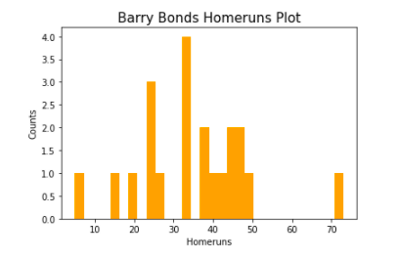
Barry Bonds-Histogram

Slide 6
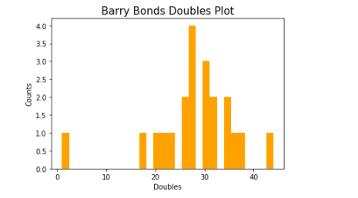
Barry Bonds-Histogram

Slide 7
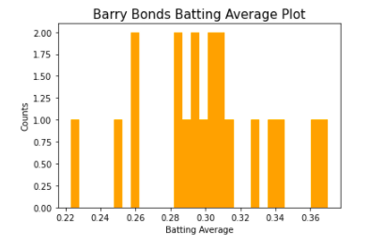
Barry Bonds-Histogram

Slide 8
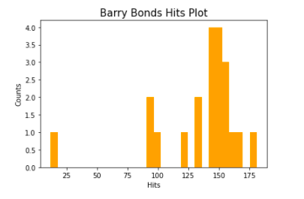
Barry Bonds-Histogram

Slide 9
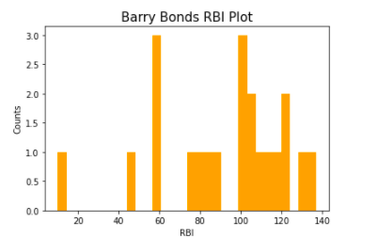
Barry Bonds-Histogram

Slide 10
Barry Bonds Outliers
Best homerun season for Bonds was his 70hr season, which is an outlier for the data
Bonds also had one bad season for RBIs, Doubles, Hits, and Batting Average which can be considered an outlier
The homerun season was at the peak of his career, and the bad season was at the end of his career thus, why they are outliers
Even though these are outliers statistically, our study is looking at peak age for a superstar, so this is information to keep

Slide 11
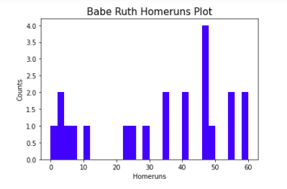
Babe ruth-Histogram

Slide 12
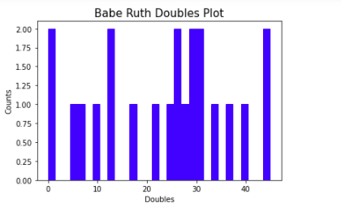
Babe ruth-Histogram

Slide 13
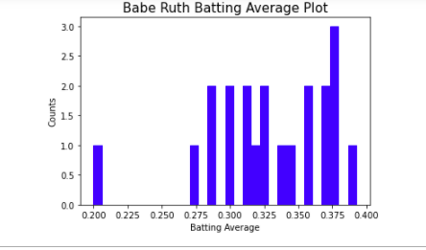
Babe ruth-Histogram

Slide 14
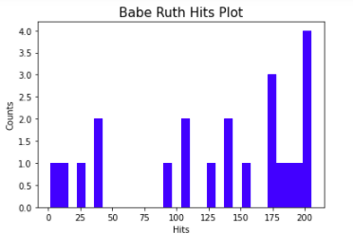
Babe ruth-Histogram

Slide 15
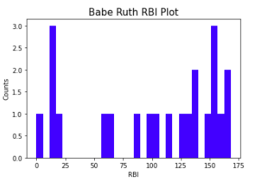
Babe ruth-Histogram

Slide 16
Babe Ruth Outliers
Looking at Babe Ruth’s statistics it is a little different because his true hitting career until 6 seasons in
The main outlier is for Batting Average from the beginning of his career with the Red Sox
These statistics aren’t a proper representation of Ruth’s career, it has some impact on his peak age

Slide 17
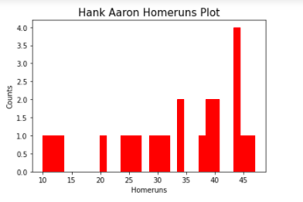
Hank Aaron-histogram

Slide 18
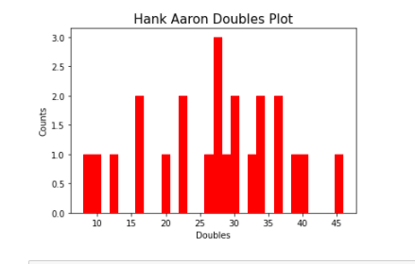
Hank Aaron-histogram

Slide 19
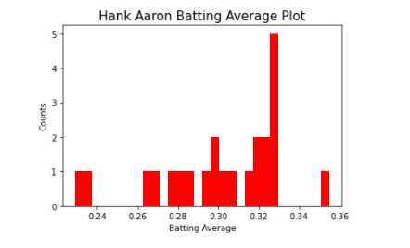
Hank Aaron-histogram

Slide 20
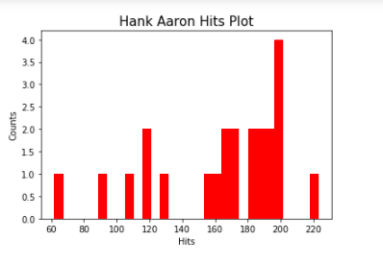
Hank Aaron-histogram

Slide 21
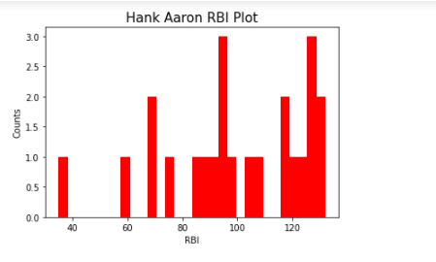
Hank Aaron-histogram

Slide 22
Hank Aaron Outliers
Hank Aaron has one outlier for both Hits and RBIs which came at the end of his career
Overall his statistics do not appear to be skewed

Slide 23
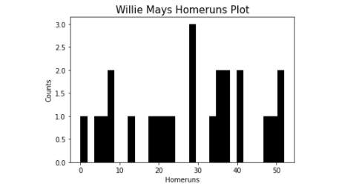
Willie Mays-Histogram

Slide 24
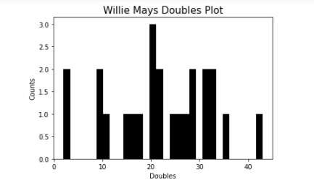
Willie Mays-Histogram

Slide 25
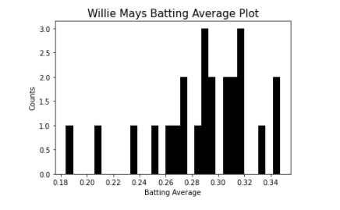
Willie Mays-Histogram

Slide 26
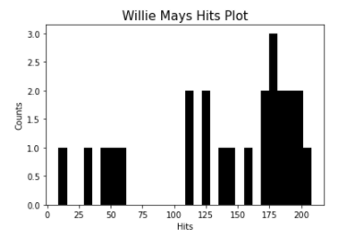
Willie Mays-Histogram

Slide 27
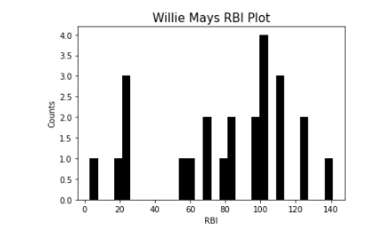
Willie Mays-Histogram

Slide 28
Willie Mays
Overall, Willie Mays does not have any true outliers from looking at the histograms
His statistics do skew to the left tail for many
One reason for the skewness of his stats is because he did miss some time during the prime of his career to go to war
We will drop the season where we have N/A

Slide 29
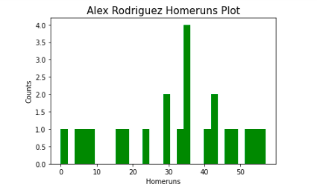
Alex Rodriguez-Histogram

Slide 30
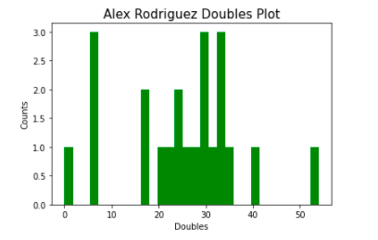
Alex Rodriguez-Histogram

Slide 31
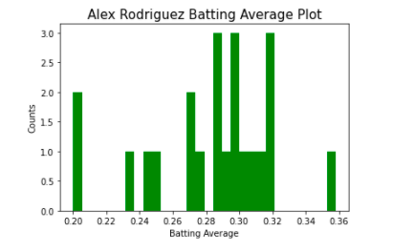
Alex Rodriguez-Histogram

Slide 32
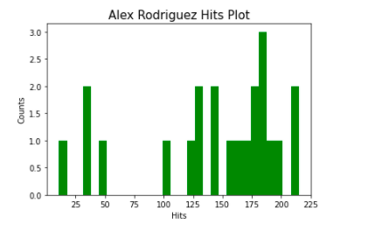
Alex Rodriguez-Histogram

Slide 33
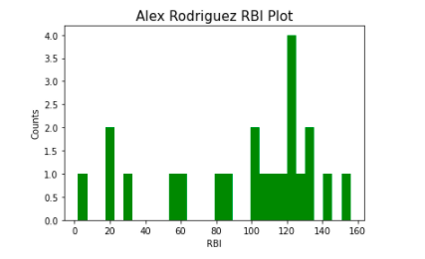
Alex Rodriguez-Histogram

Slide 34
Alex Rodriguez Outliers
Like Barry Bonds, Alex Rodriguez has outliers that appear to come from the prime of his career and the end of his career
His abilities diminished and he also received suspensions at the end of his career causing these outliers
But, because we are looking for a prime of career we can assume these outliers may have still occurred
We will drop the season where we have N/A

Slide 35
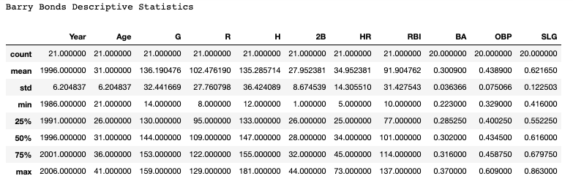
Barry Bonds Descriptive Statistics

Slide 36
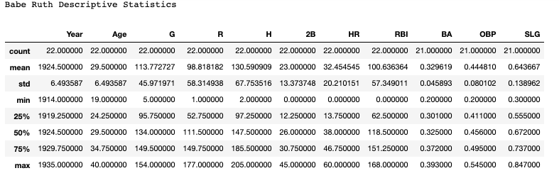
Babe Ruth Descriptive Statistics

Slide 37
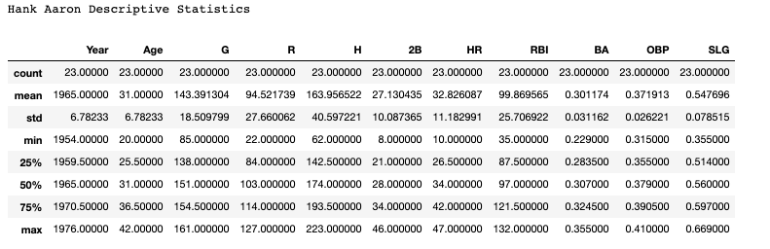
Hank Aaron Descriptive Statistics

Slide 38
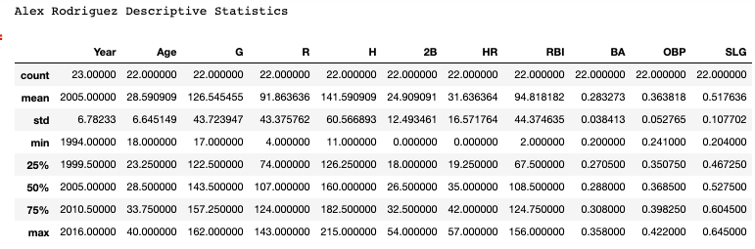
Alex Rodriguez Descriptive Statistics

Slide 39
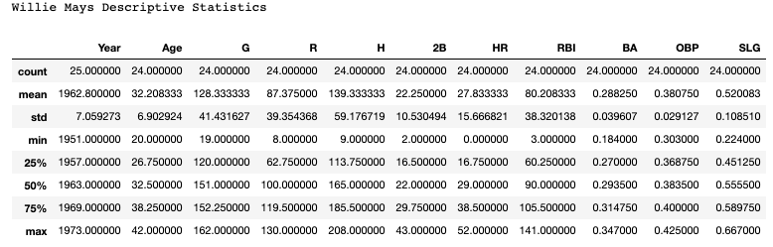
Willie Mays Descriptive Statistics

Slide 40
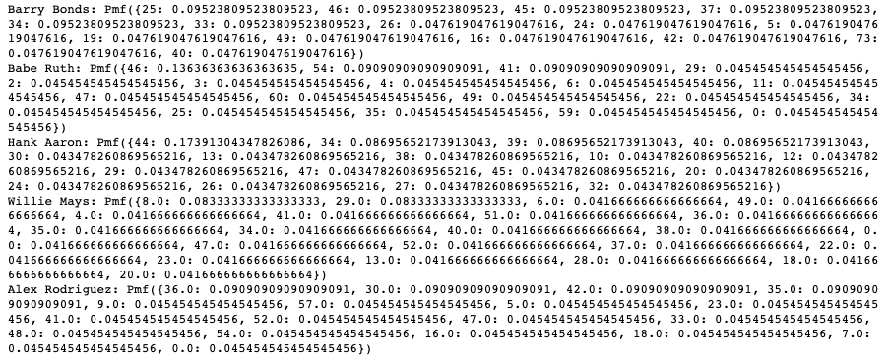
PMF Homeruns

Slide 41
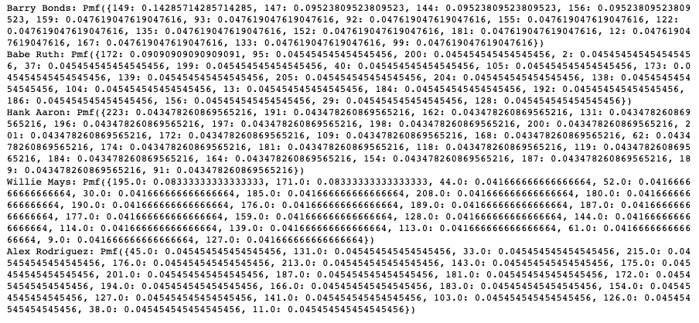
PMF Hits

Slide 42
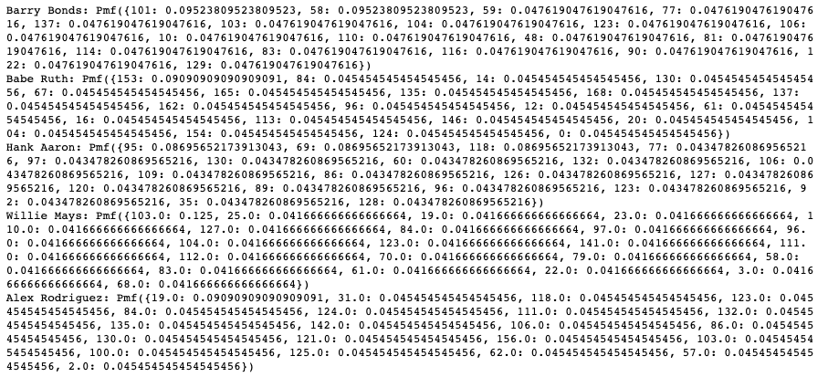
PMF RBI

Slide 43
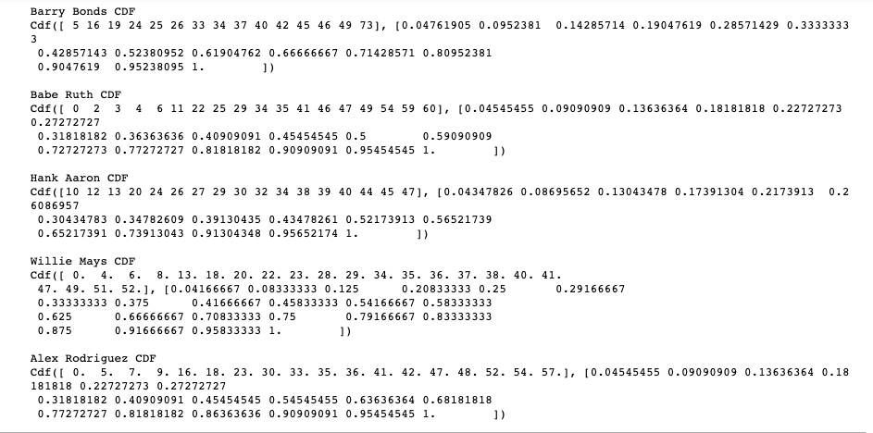
CDF Homeruns

Slide 44
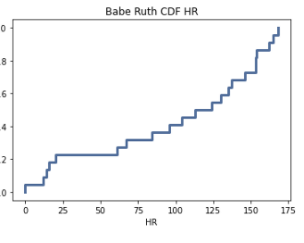
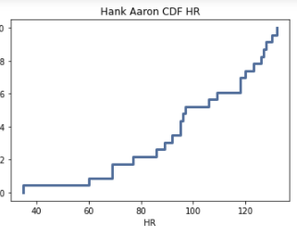
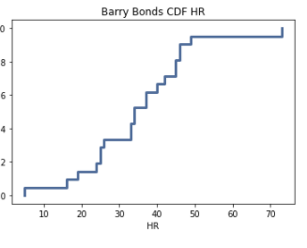
CDF Homeruns

Slide 45
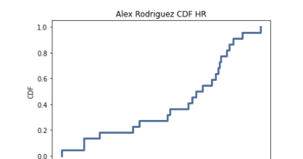
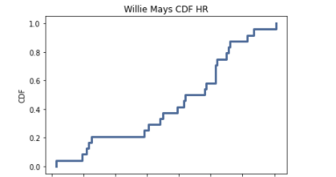
CDF Homeruns

Slide 46
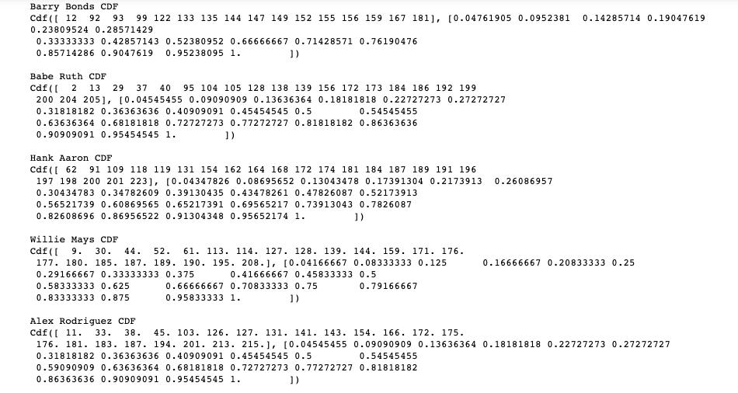
CDF RBI

Slide 47
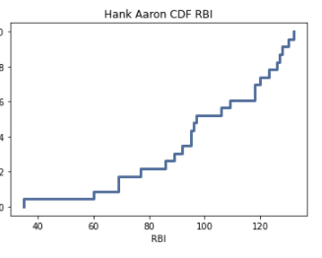
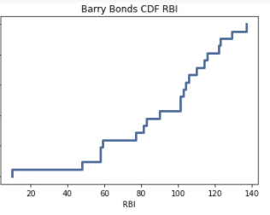
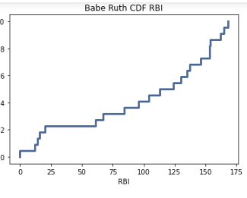
CDF RBI

Slide 48
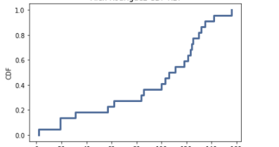
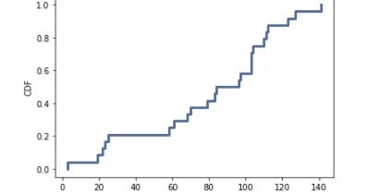
CDF RBI

Slide 49
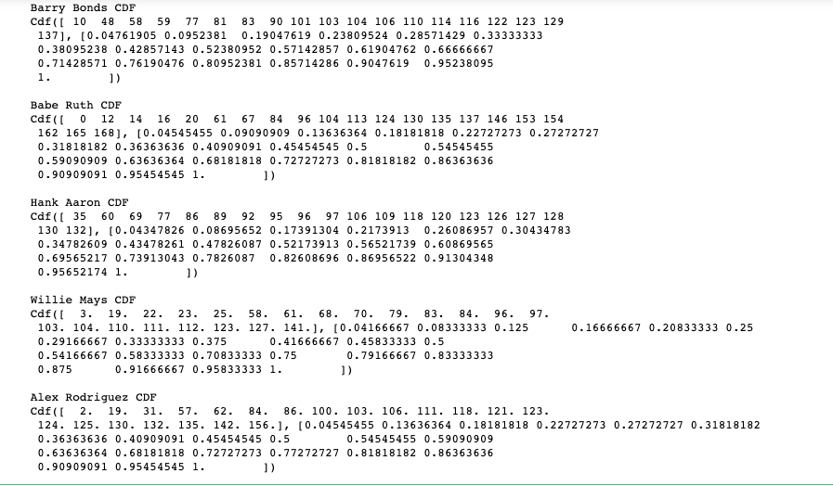
CDF Hits

Slide 50
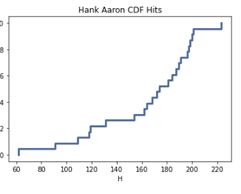
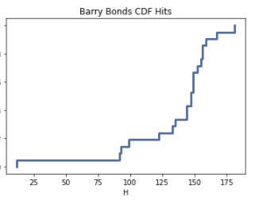
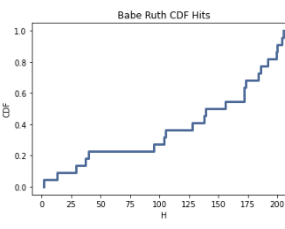
CDF Hits

Slide 51
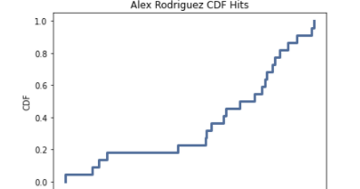

CDF Hits

Slide 52



Normal Distribution Plot Homeruns

Slide 53


Normal Distribution Plot Homeruns

Slide 54

Barry Bonds Correlation

Slide 55

Babe Ruth Correlation

Slide 56

Hank Aaron Correlation

Slide 57

Willie Mays Correlation

Slide 58

Alex Rodriguez Correlation

Slide 59
Scatter Plot comparison
The following scatter plots will look at the variable age compared to both homeruns and hits
Looking at the graphs there can be seen a negative inverse relationship for some of the players and both statistics
This shows that as age goes up, performance decreases
We can see at the above correlation values as well where there are positive and negative relationships

Slide 60
Hypothesis Test
I performed a correlation test to see the relationships between a few different hitting variables comparing them to age
The goal was to see if there is any type of correlation through looking at the p-values for the specific players and their abilities over time
The p-values show that statistics like HR and RBIs are two of the stats that drop off as age goes up
Whereas for some of the players Hits and Batting average are statistically significant

Slide 61



P-Values

Slide 62


P-Values

Slide 63



Linear Regression

Slide 64


Linear Regression

Slide 65

Conclusion
Looking at the data presented we see there is a correlation between age and performance
As most players worst performances come at the beginning of their careers and end of their careers
Overall, the data shows that with the players we looked at they peak around age 25, hitting another peak in their early 30s.
The exception to this was Barry Bonds, who overall was an outlier himself

Slide 66
References
All data came from: www.baseball-reference.com
MLB Stats, Scores, History, & Records. (n.d.). Baseball-Reference.Com. https://www.baseball-reference.com/

